Slide 1
An Analysis Of Factors Associated With Child Mortality Rates.
By Lea asopjio

Slide 2
LEARNING QUESTION
Question: Which factors are most associated with under-five and infant deaths?
Importance:
Understanding these factors helps identify areas for public health intervention.
Insights can guide policymakers to allocate resources effectively to reduce child mortality rates.

Slide 3
1. DATASET OVERVIEW
Source: Kaggle (information officially derive from WHO)
Rows: 2,939 observations from multiple countries (2010-2015).
Features: 22 columns encompassing health, socioeconomic, and demographic factors.
Dependent Variables: Under-five deaths, infant deaths.
Independent Variables: GDP, vaccination rates (Hepatitis B, Polio, Diphtheria), healthcare expenditure, BMI, alcohol consumption, HIV/AIDS, adult mortality, status and schooling.

Slide 4
2. ANALYSIS PROCESS: Data Wrangling
MAR Data
MNAR Data
    Large Extent (>= 200 missing values): Used Iterative Imputation (MICE) for columns such as Hepatitis B (553 missing values) and GDP (448 missing values).
    Moderate Extent (50 to 200 missing values): Applied KNN Imputation for columns like Total Expenditure (226 missing values) and Schooling (163 missing values).
    Small Extent (<= 50 missing values): Used Mean Imputation for Polio (19 missing values) and Diphtheria (19 missing values), and Median Imputation for Adult Mortality (10 missing values).
    BMI (34 missing values): Used Median Imputation to handle smaller missingness extent.
    Alcohol (194 missing values): Predicted missing values using a Random Forest model trained on non-missing rows.

Slide 5
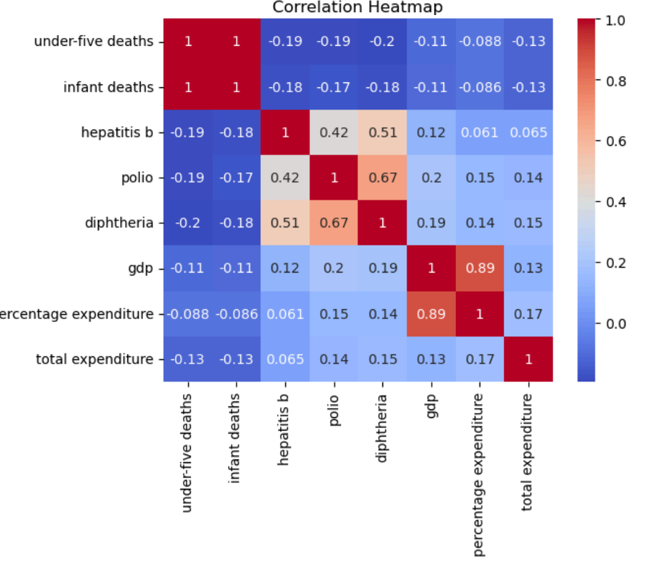
2. ANALYSIS PROCESS: Data Exploration
Heatmap revealed multicollinearity among features.
Conducted VIF calculation to address multicollinearity. In my case, they all have 1 < VIF < 5: Moderate multicollinearity which are generally acceptable VIF scores.

Slide 6
2. ANALYSIS PROCESS: Model Selection
A) Linear Regression: Tested for baseline interpretability.
B) Random Forest: Leveraged for feature importance and non-linear relationships.
C) Gradient Boosting (XGBoost): For enhanced predictive performance and feature importance ranking.

Slide 7
A) Linear Regression
Used as a baseline to test interpretability and understand linear relationships between predictors and targets.
Assumptions of linear regression were tested (linearity, normality of residuals, multicollinearity).
Performance was poor due to non-linear relationships, high variance in data, and outliers.
High MSE: The model’s predictions deviate significantly from the actual values.
Under-Five Deaths (Log Transformed) | Infant Deaths (Log Transformed)
MSE -> 35435.698525620406 R^2 Score -> -0.010583119539246733 | MSE -> 19689.880834650907 R^2 -> -0.012259715372516578

Slide 8
B) Random Forest
  Selected for its ability to handle non-linear relationships and interactions between features.
  Provided feature importance rankings, which were useful for identifying the most influential factors.
  Delivered better performance than linear regression, particularly for datasets with complex patterns.
Compare with Linear Regression
Under-Five Deaths: MSE: 8028.42 (lower MSE compared to the Linear Regression model indicates better performance). R² Score: 0.77 (a reasonably strong R² score indicates that about 77% of the variance in under-five deaths is explained by the model).
Infant Deaths: MSE: 4672.47 (again, much better compared to Linear Regression). R² Score: 0.76 (similarly, 76% of the variance in infant deaths is explained by the model).

Slide 9
C) Gradient Boosting (XGBoost)
Chosen for its robust handling of non-linear relationships and incremental learning approach.
Hyperparameters such as learning rate and tree depth were optimized to enhance performance.
Slightly lower R² compared to Random Forest but highlighted similar key features, reinforcing consistency.
Under-Five Deaths | Infant Deaths
MSE: 8942.94835138696 R2 Score: 0.7449579655869147 | MSE: 4667.296247483385 R2 Score: 0.7600536026240248

Slide 10
3. Model & Metrics
Random Forest:
Overview:
  A non-linear ensemble method that combines multiple decision trees for more robust predictions.
  Captures interactions between features and reduces overfitting through bagging.
Performance Metrics:
  MSE (Under-Five Deaths): 8028.42 | R²: 0.7710.
  MSE (Infant Deaths): 4672.47 | R²: 0.7598.
Key Insights:
  Highlighted key features such as HIV/AIDS, Total Expenditure, and BMI as critical predictors.

Slide 11
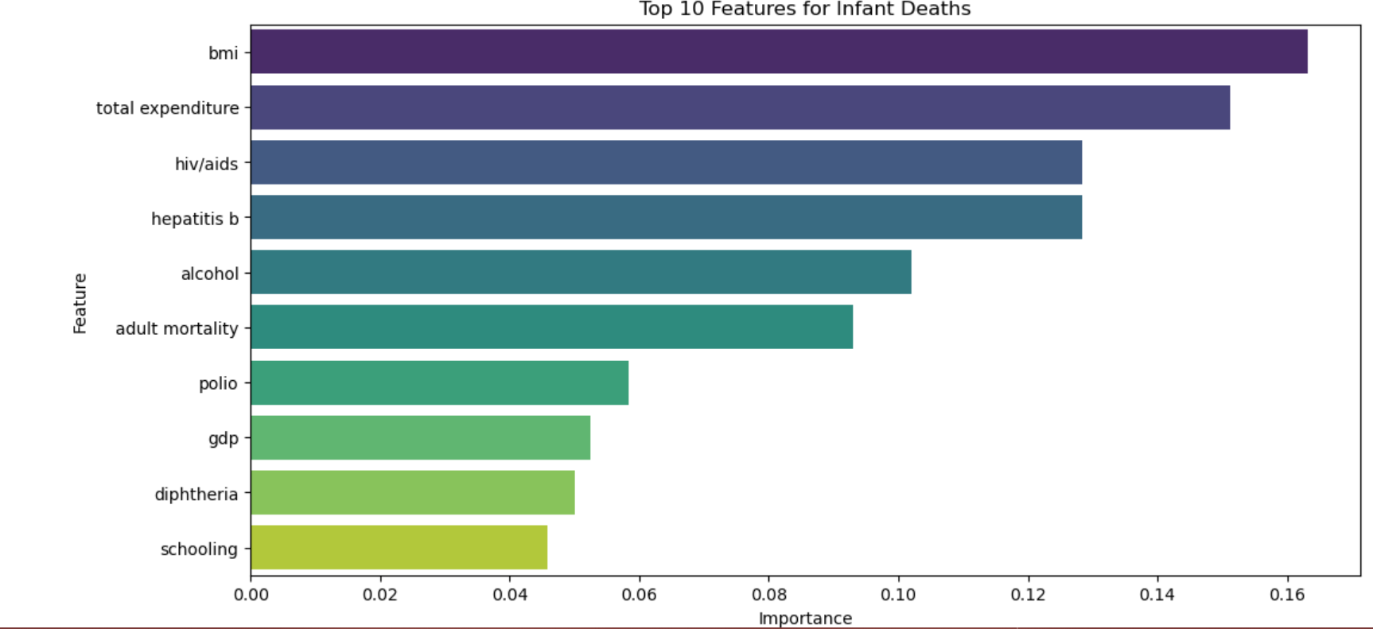
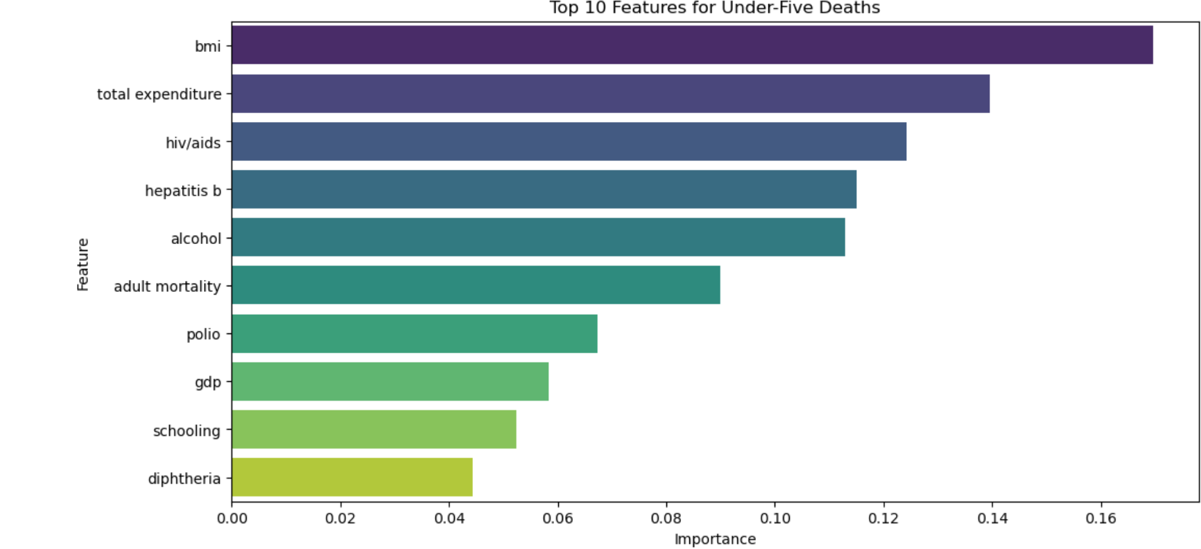
Key Features Importance from Random Forest

Slide 12
CONCLUSION:
Key Insights from Visuals
Under-five deaths and Infant Deaths have the same top features. These features are the factors that are mostly associated with the rate of under-five deaths and infant deaths in those countries.
BMI consistently emerges as the most critical factor for both under-five and infant mortality. This suggests a strong link between population nutrition and child mortality rates.
Total Healthcare Expenditure is the second most important feature, highlighting the need for robust investment in public health systems to reduce child mortality.
Vaccination (Hepatitis B) and HIV/AIDS emphasize the importance of disease prevention and management, particularly in developing nations.
Alcohol Consumption likely represents indirect societal or economic factors affecting child mortality.
These insights should guide targeted health interventions like improving nutrition, increasing vaccination coverage, and boosting healthcare funding.

Slide 13
4. Application, Limitations, and Ethical Considerations
Applications:
Inform health campaigns focusing on vaccination and HIV/AIDS prevention.
Guide financial resource allocation towards impactful healthcare interventions.
Limitations:
Missing data imputation relies on assumptions that could introduce bias.
Limited temporal scope (2010-2015) restricts trend analysis.
Ethical Considerations:
Fairness: Ensure predictions do not disadvantage resource-limited regions.
Bias: Data from developing nations may be less reliable while developed countries may have more complete and accurate data.

Slide 14
References
Dataset: https://www.kaggle.com/datasets/kumarajarshi/life-expectancy-who

